Slide 1

WELCOME TO ALABAMA AER CHAPTER’S LEADERSHIP TRAINING INIATIVE

Slide 2
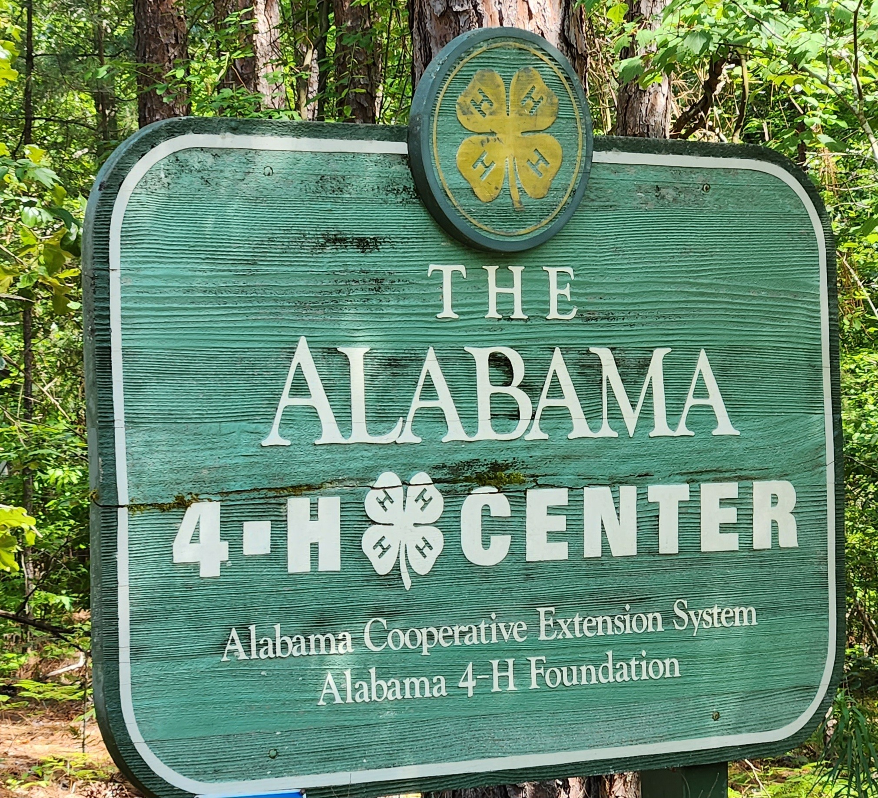

Slide 3
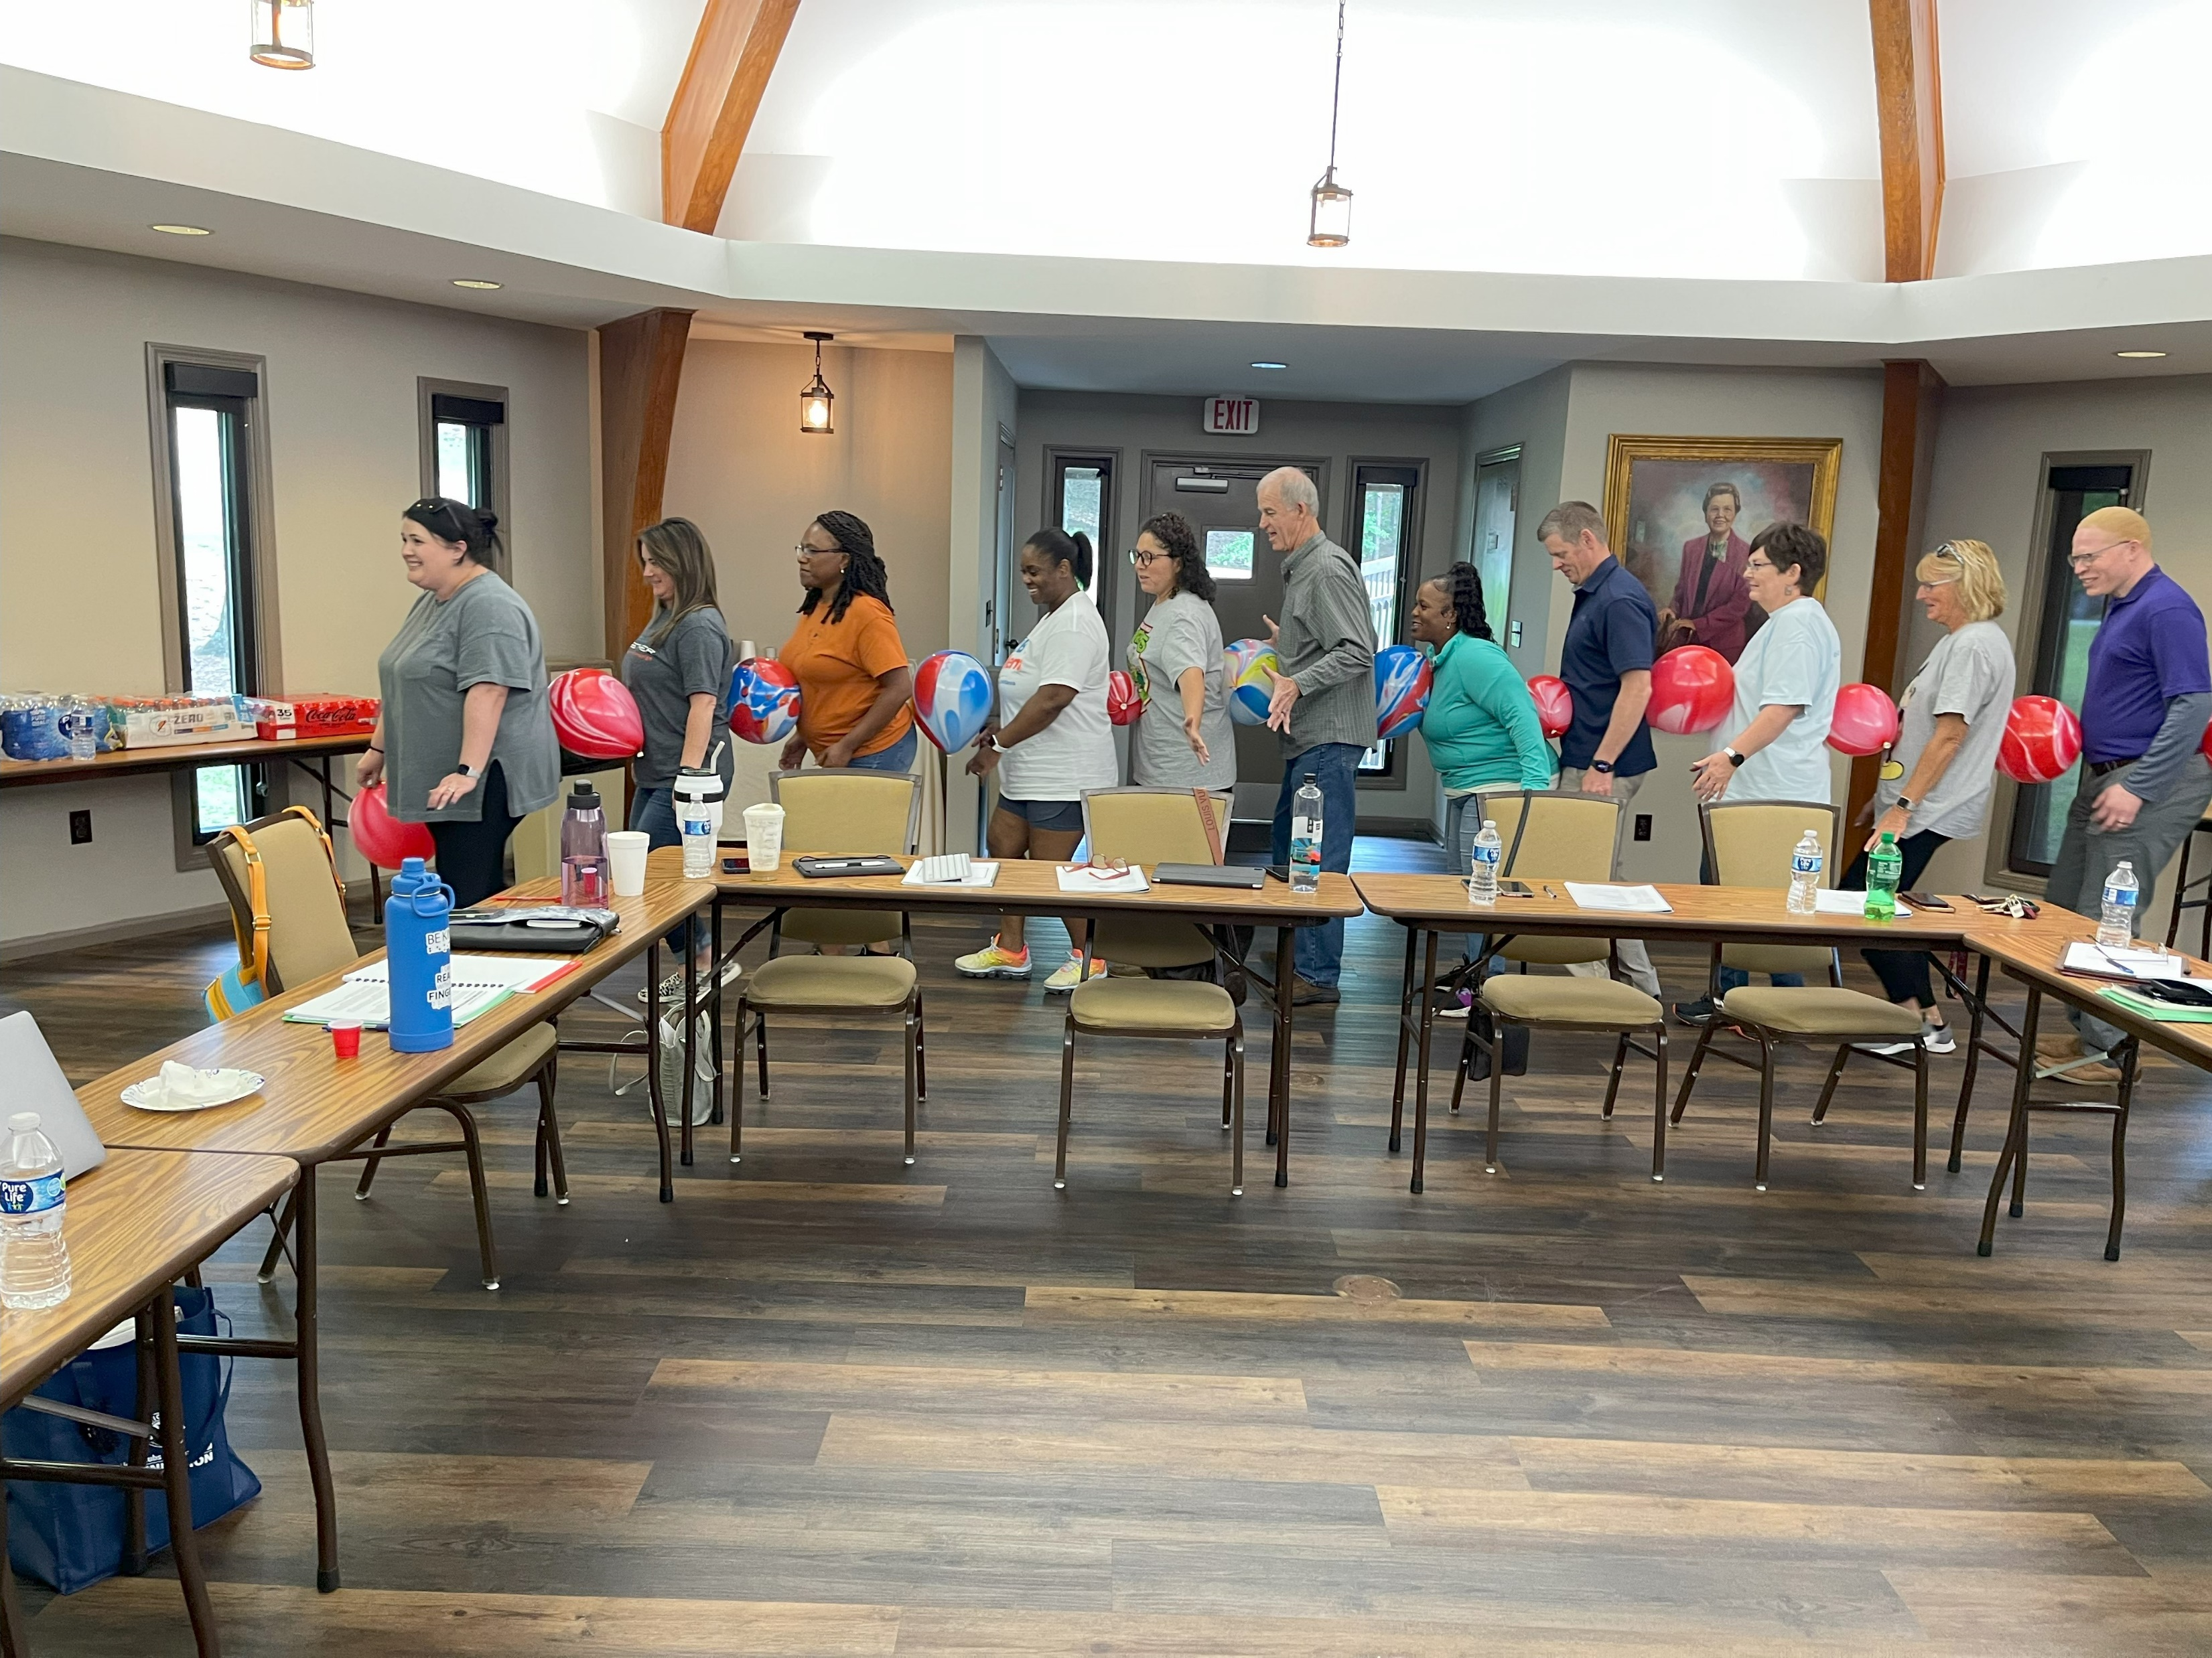

Slide 4
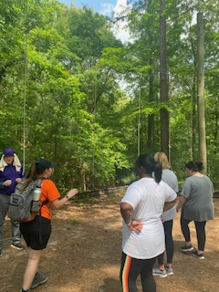
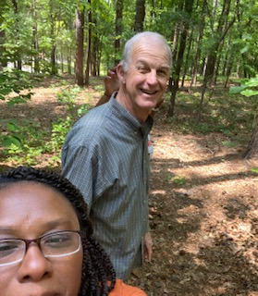
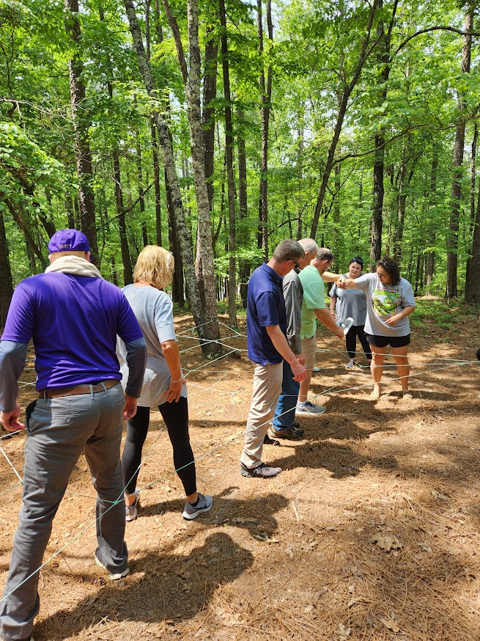
The Challenge Course Begins
Jack and LaTonya
Donte and his Magic Towel

Slide 5
Donte’s Magic Towel is WORKING!

Slide 6
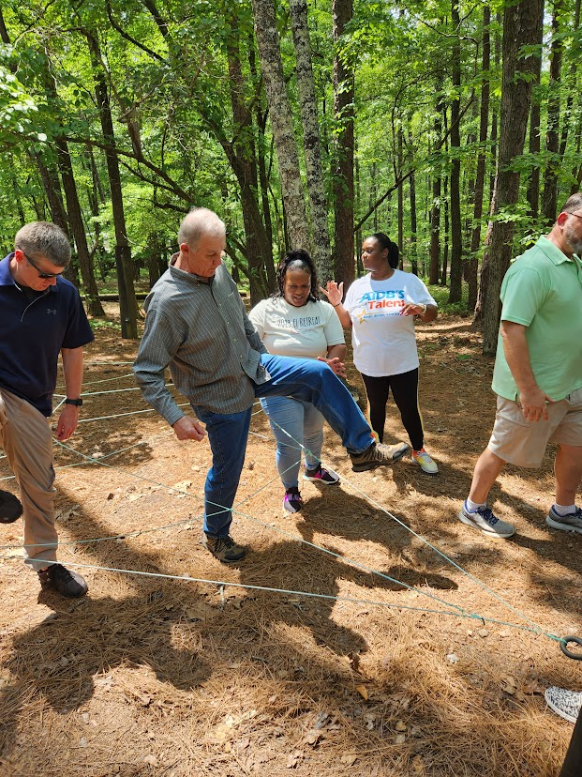
One GIANT STEP for Alabama AER!

Slide 7
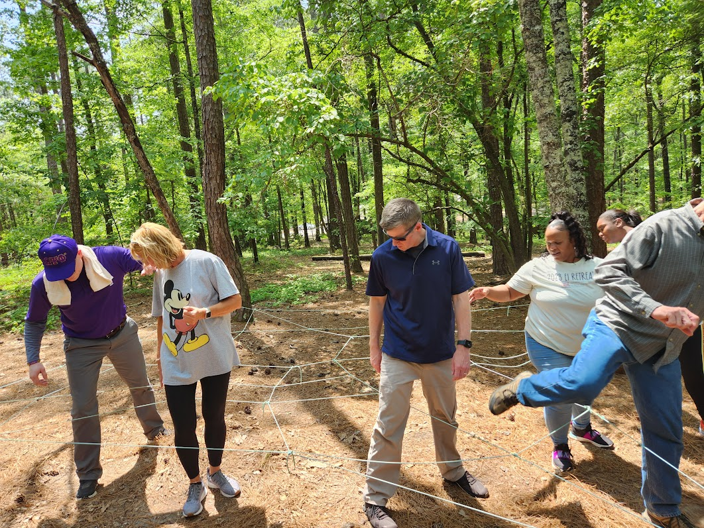
Sharon I’m telling YA this TOWEL is Magic!!!!

Slide 8
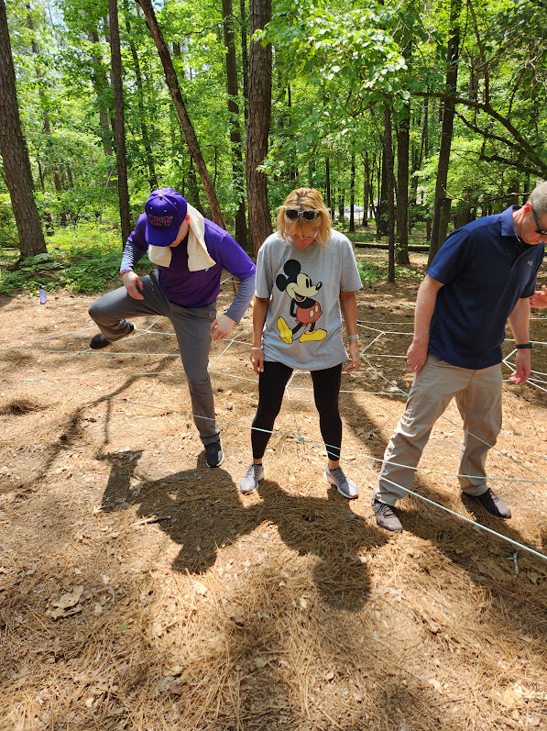
WATCH THIS
MAGIC!!

Slide 9
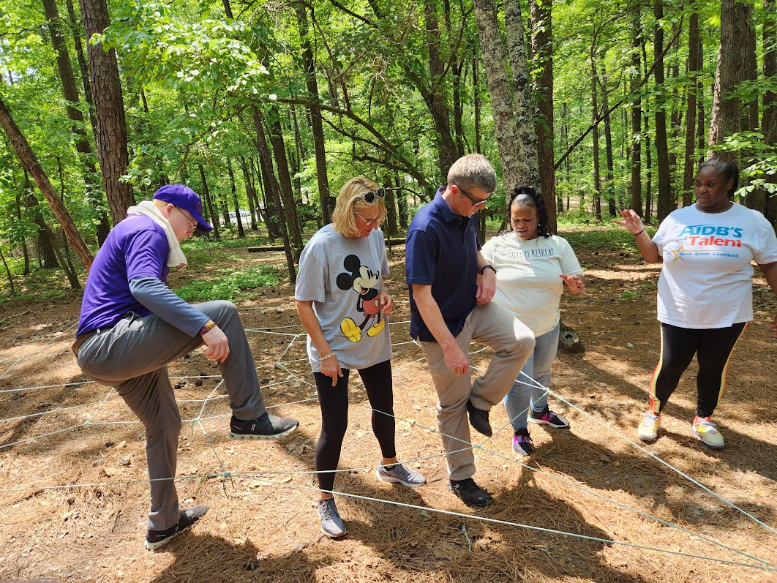
HERE COMES THE MAGIC !!!!

Slide 10
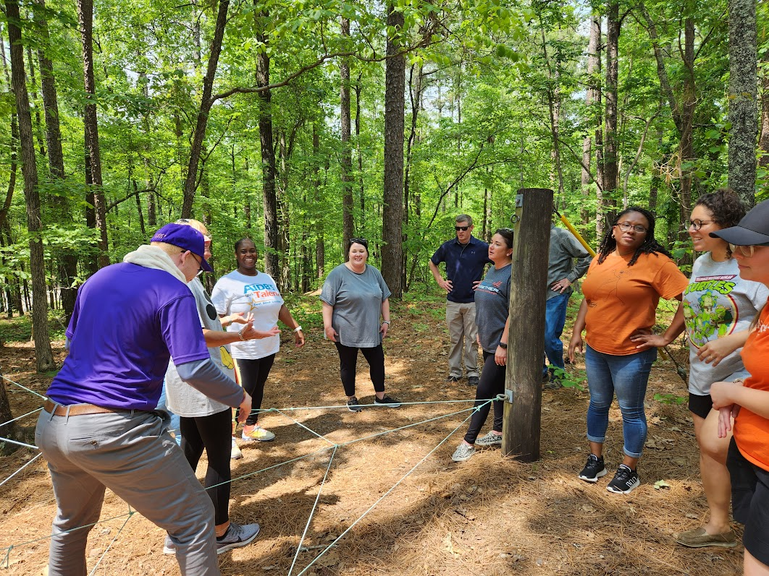

Slide 11
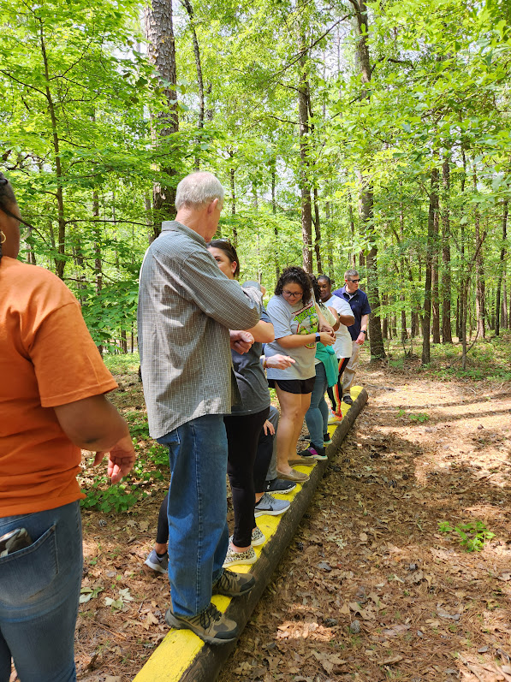
LOGROLLING
If a legislator logrolls, he initiates the trade of votes for one act or bill in order to secure votes on behalf of another act or bill. Logrolling means that two parties will pledge their mutual support, so both bills can attain a simple majority.

Slide 12
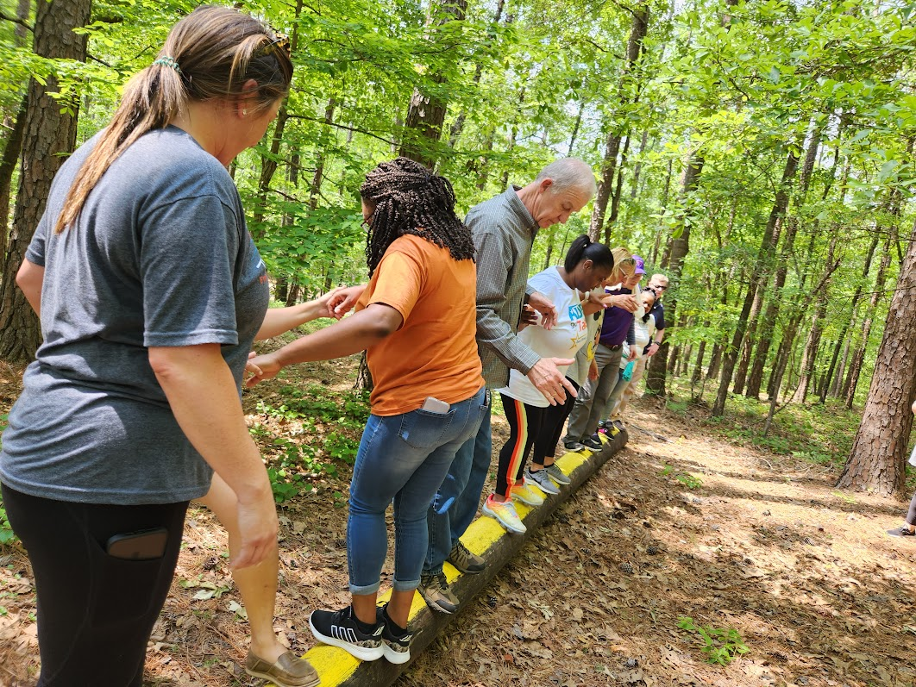

Slide 13
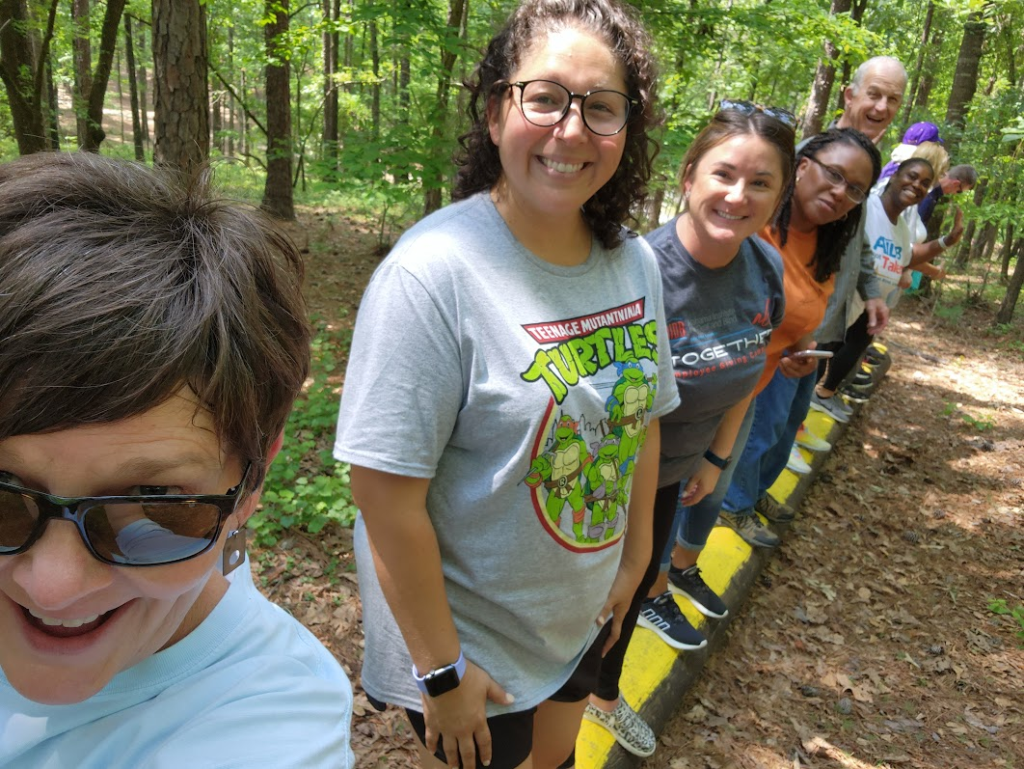
KELLEE
MAY BE OPENING UP HER CAMPAIGN OFFICE!

Slide 14
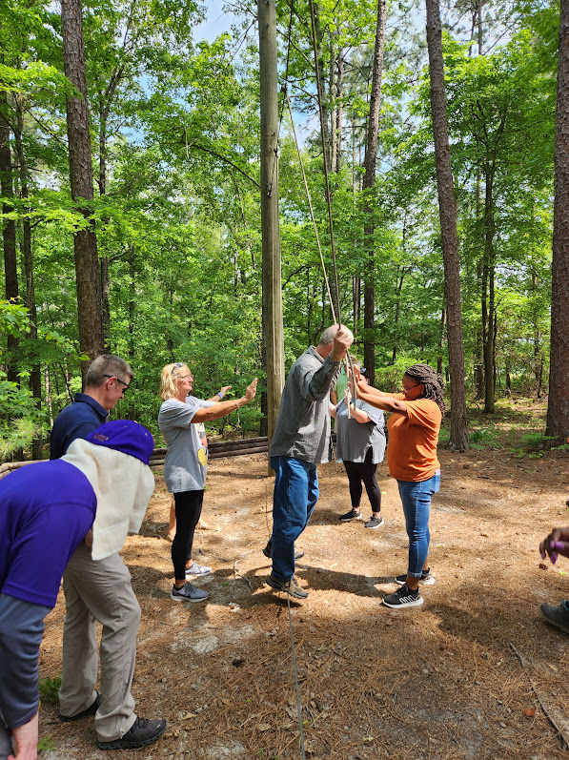
JACK DON’T WORRY WE GOTCHA!!

Slide 15
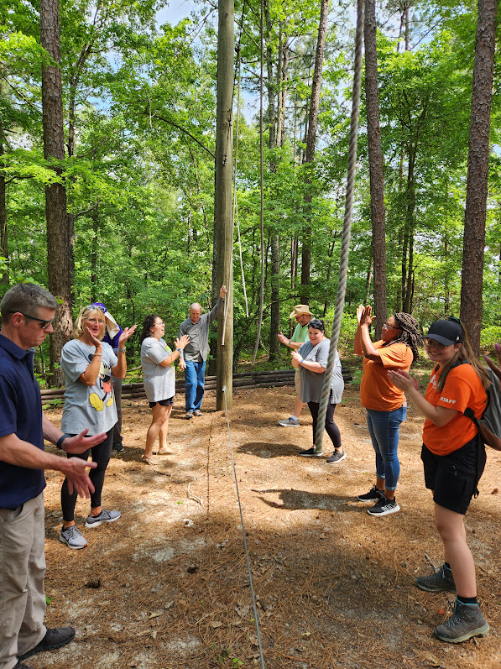
HOW ABOUT A ROUND OF APPLAUSE!!!

Slide 16
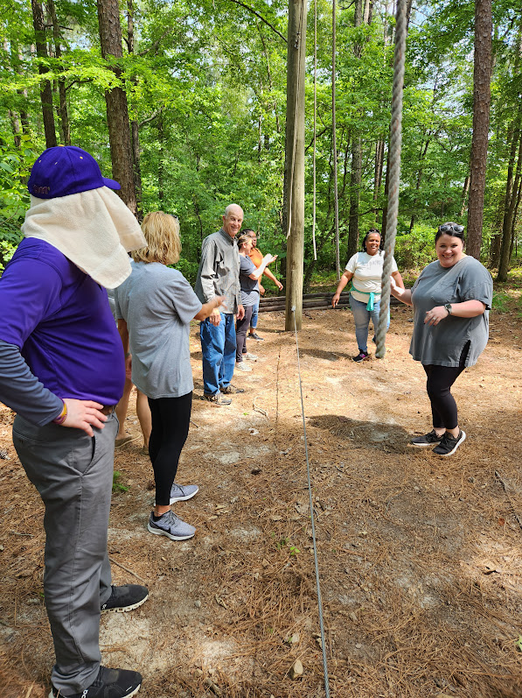
THERE’S THAT MAJIC TOWEL AGAIN!!

Slide 17
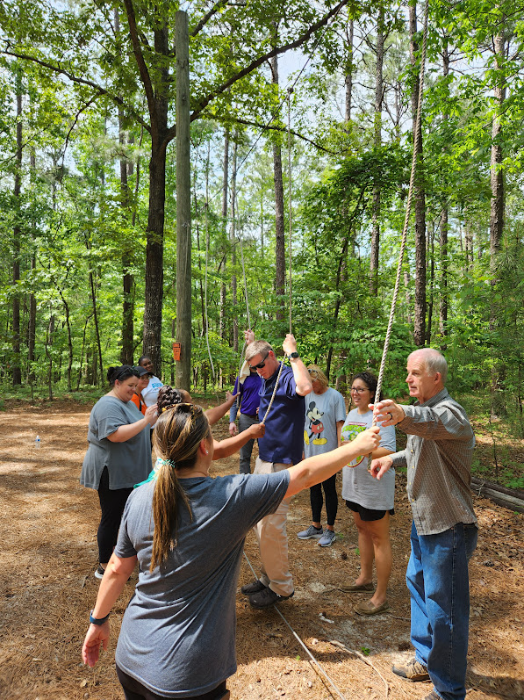
ASHLEY IS ON THE ROPES!!

Slide 18
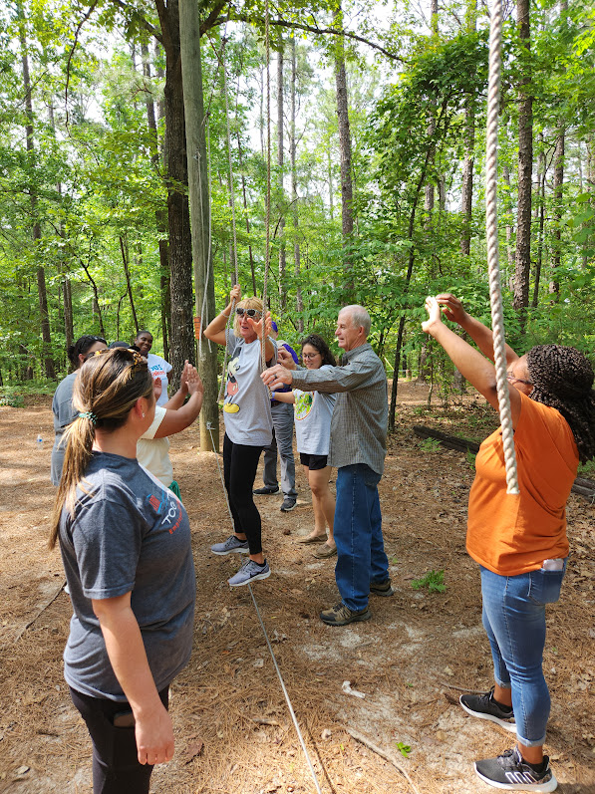
SHARON ON THE ROPES AS WELL!!

Slide 19
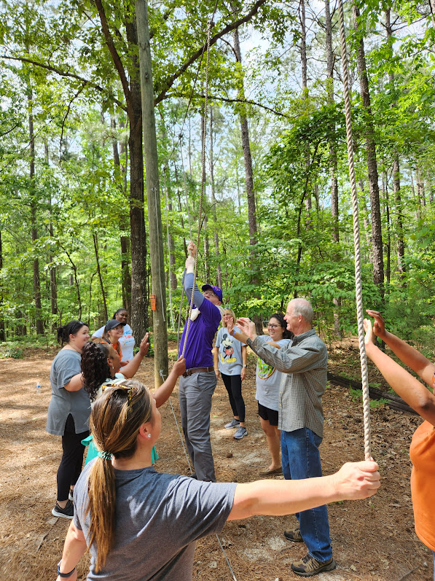
THE MAGIC TOWEL MAN THRILLS THE CROWD!!!

Slide 20
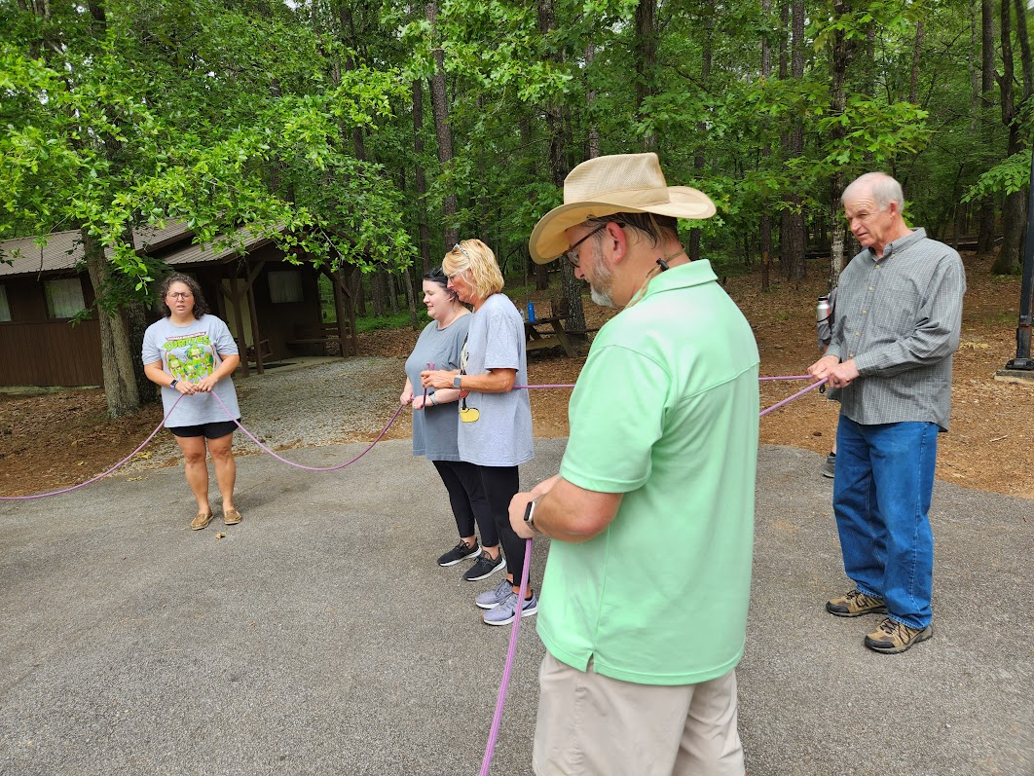
The exorcist has started!

Slide 21
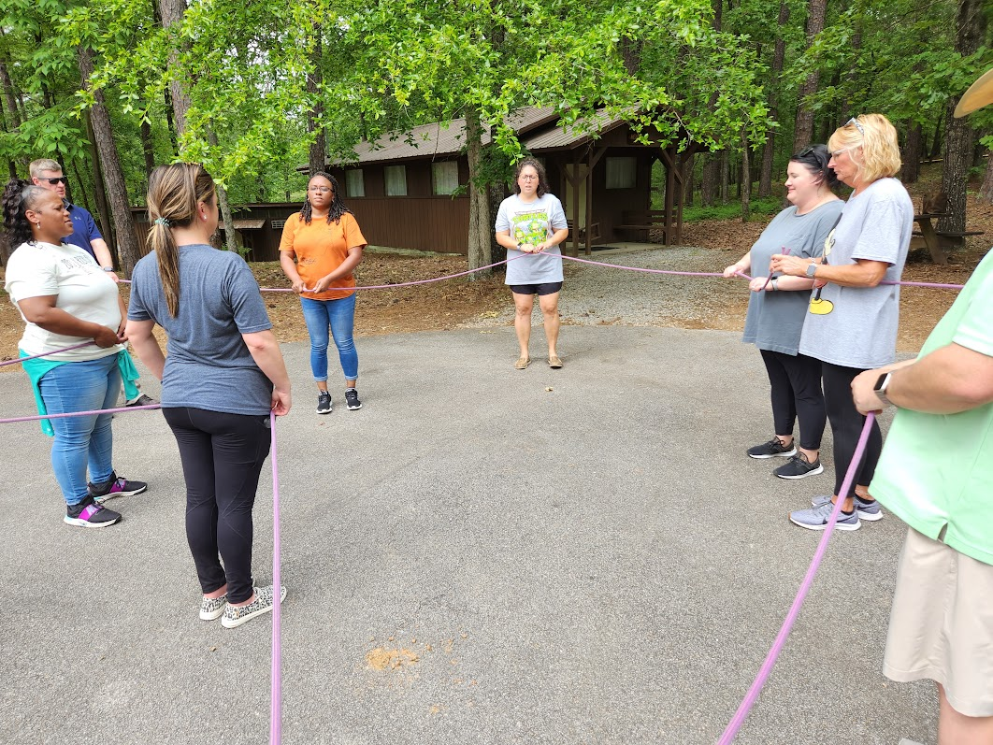
“OUT DAMN SPRIT”

Slide 22
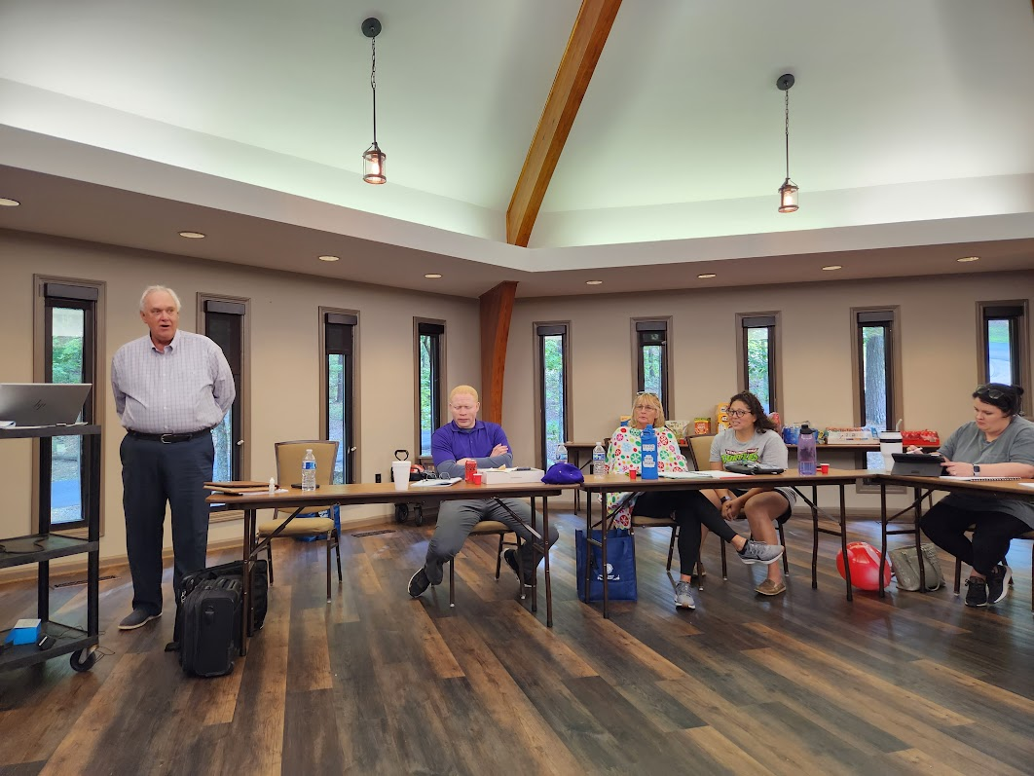

Slide 23
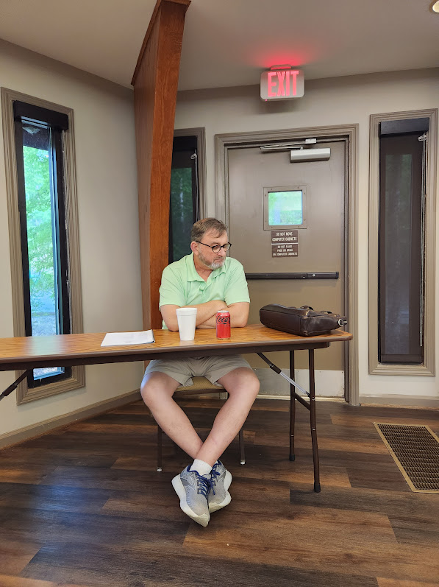
ITS LONELY AT THE TOP!!!

Slide 24
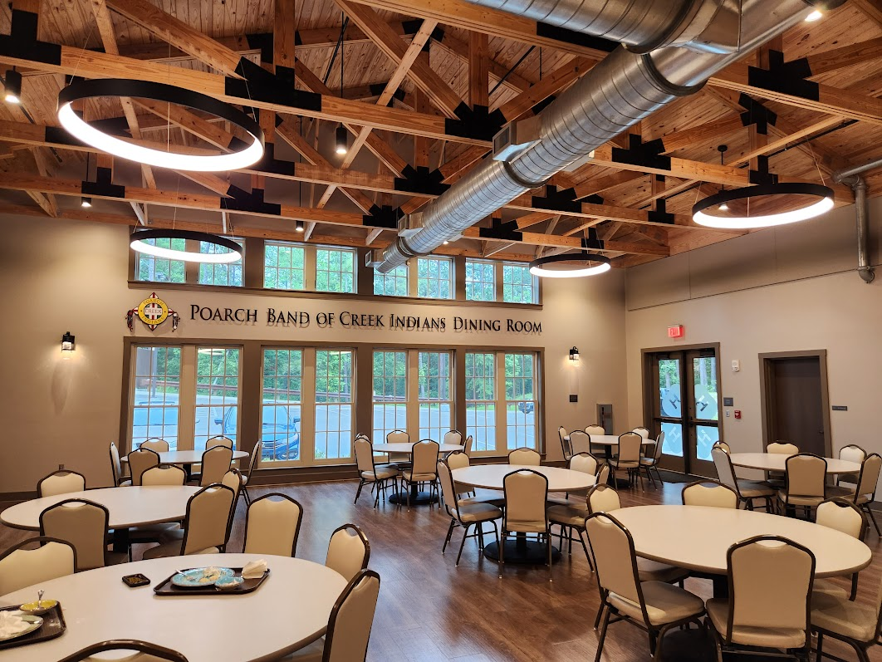

Slide 25
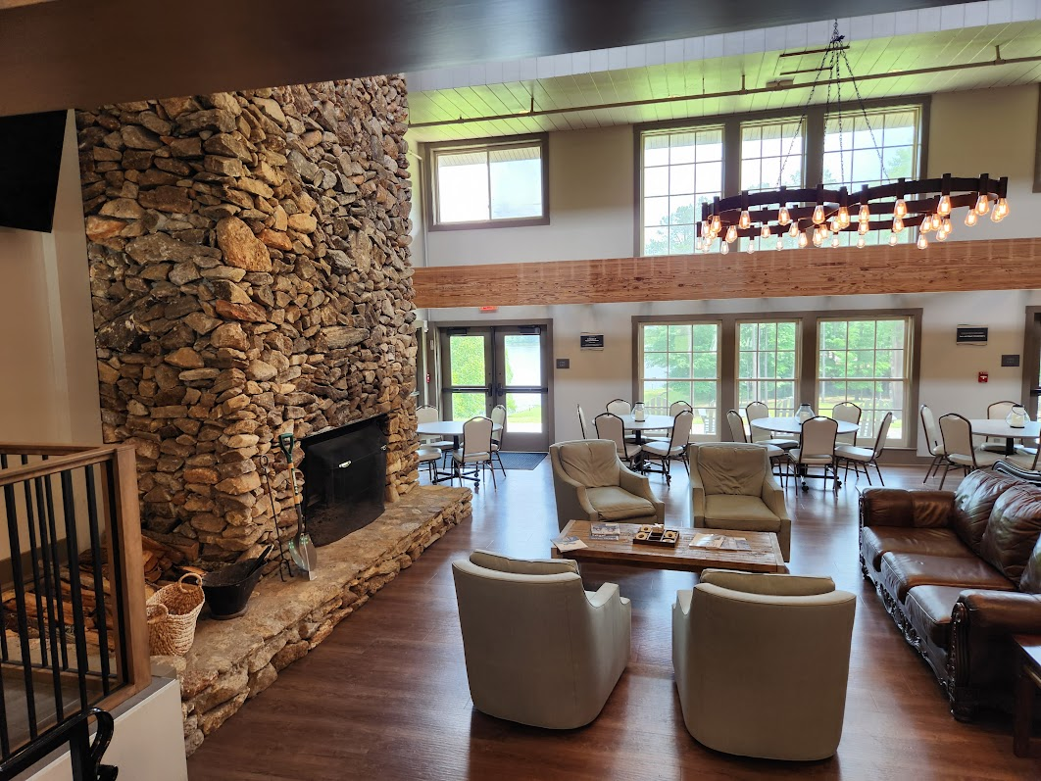

Slide 26
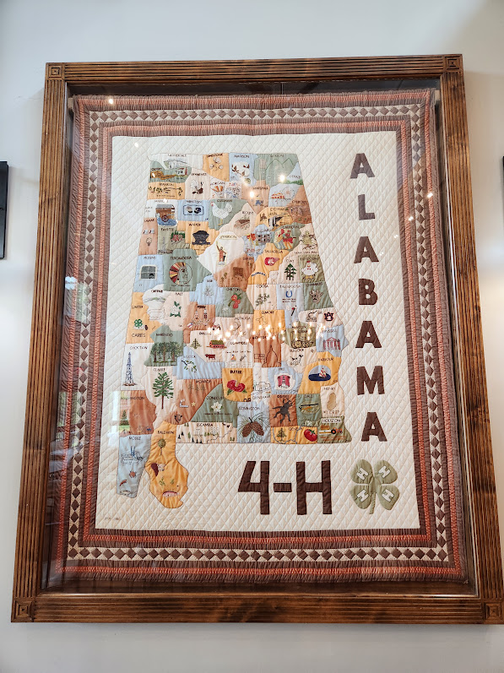

Slide 27
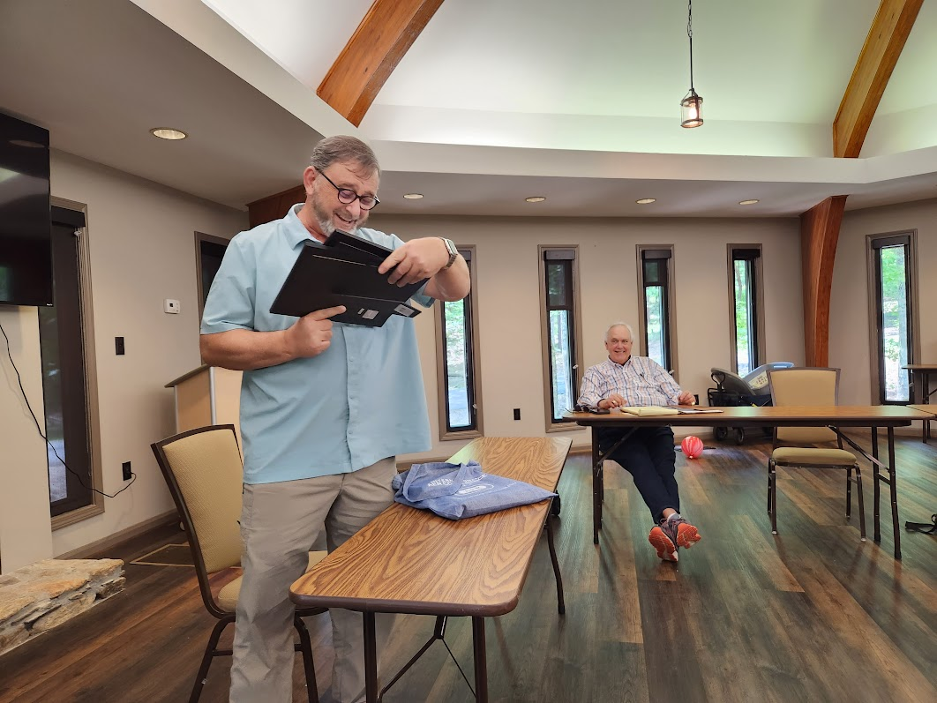
GRADUATION DAY!!!!

Slide 28
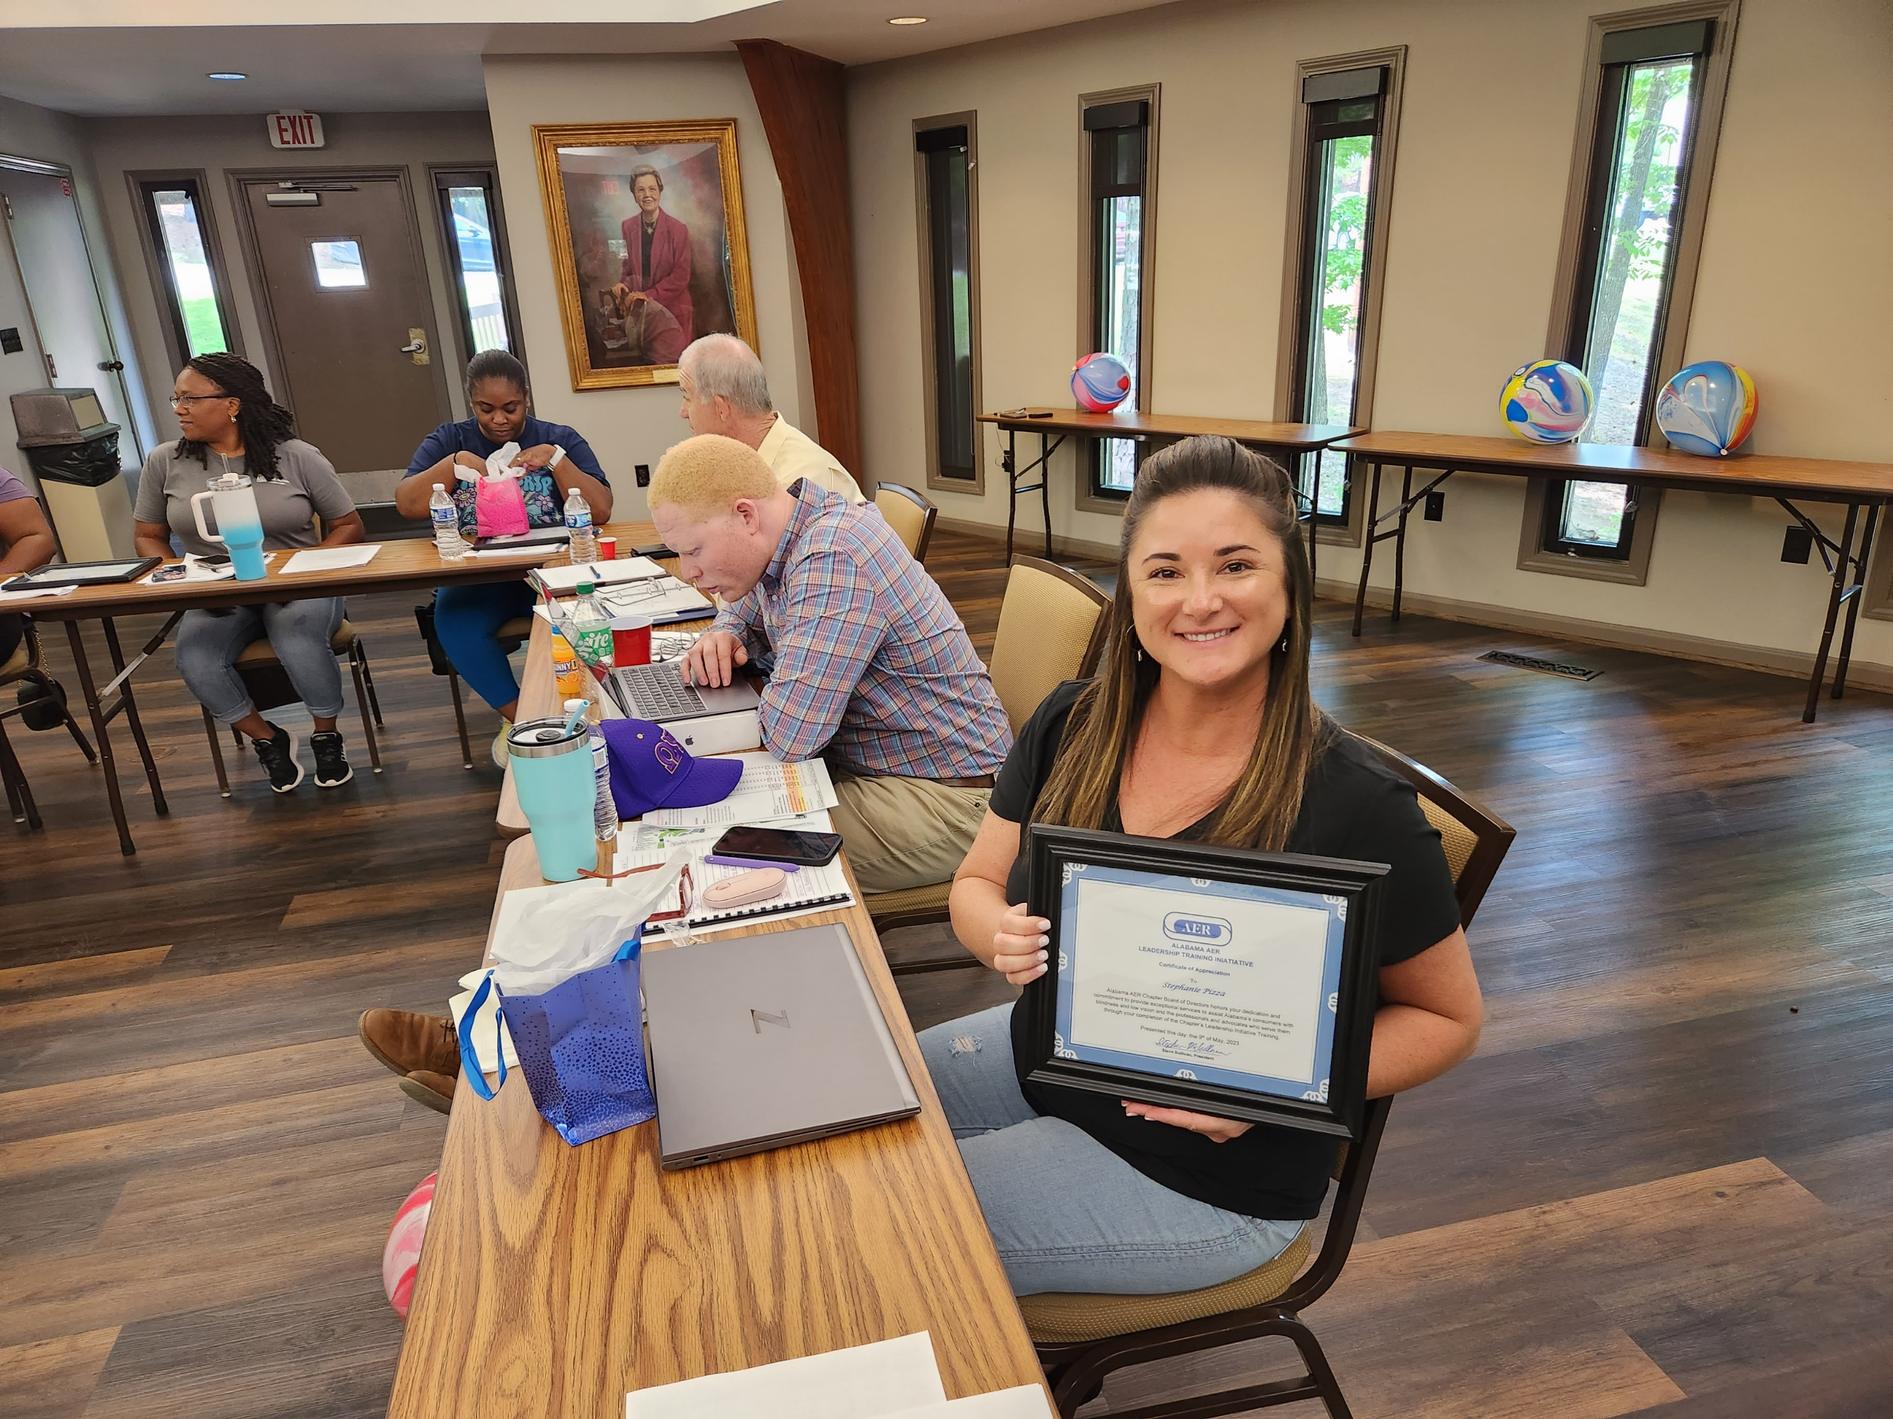
CONGRATULATIONS STEPHANIE!

Slide 29
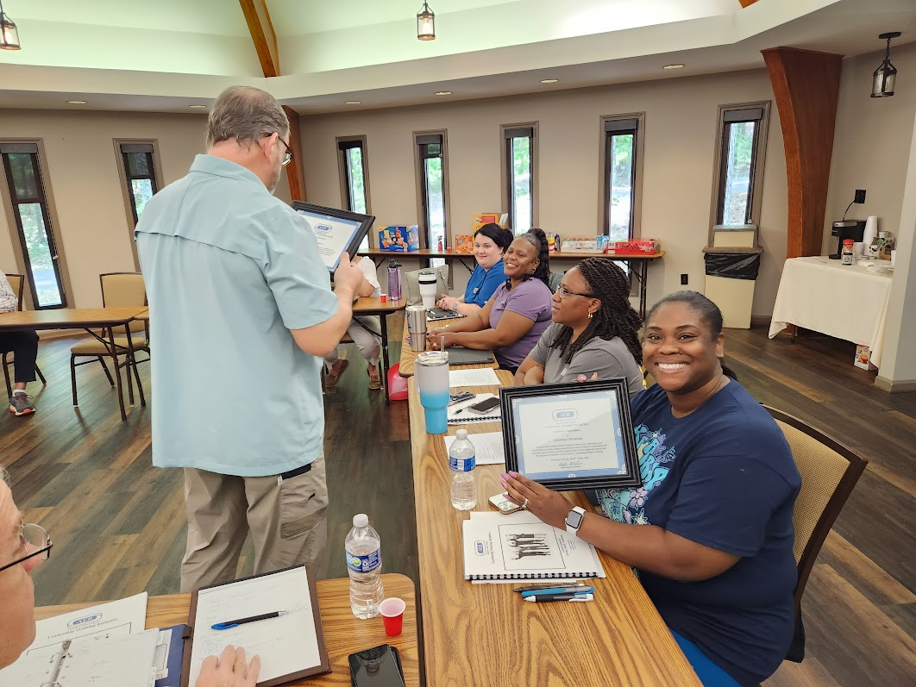
CONGRATULATIONS COURTNEY!

Slide 30
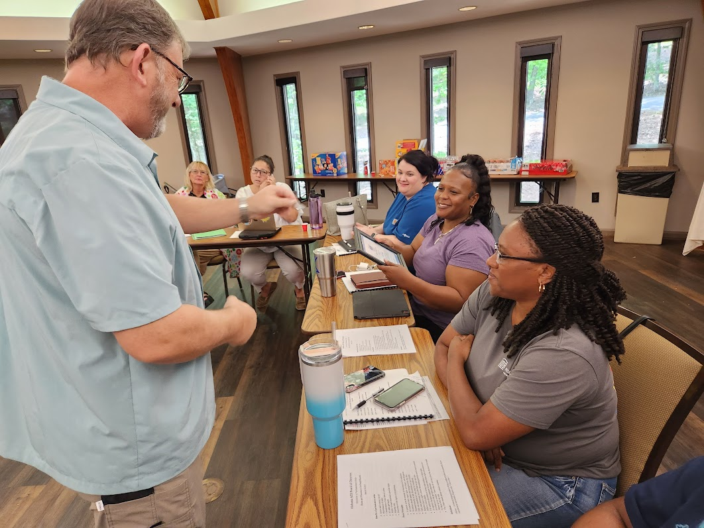
CONGRATULATIONS
MARQUITA!
STEVE PRESENTS AER PINS TO 2023 LTI PARTICIPANTS

Slide 31
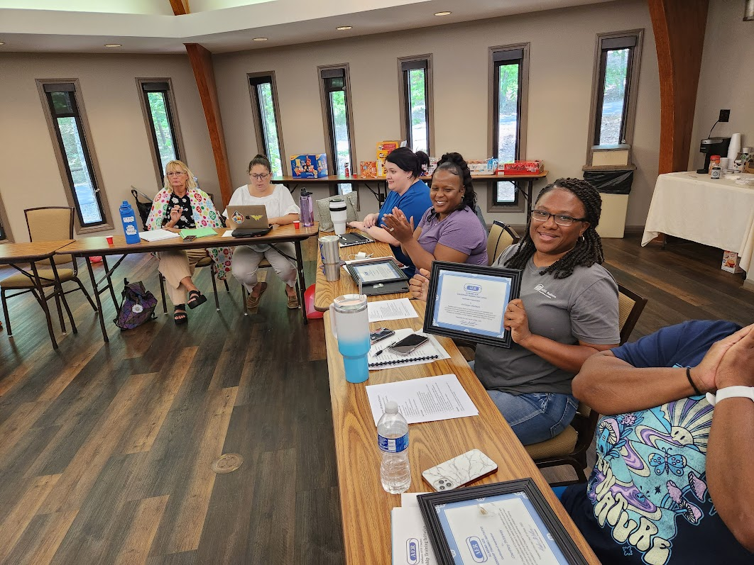
CONGRATULATIONS
LATONYA!

Slide 32
THANKS TO ALL WHO PARTICIPATED IN THE ALABAMA AER CHAPTER’S 2023 LEADERSHIP TRAINING INIATATIVE
THAT’S ALL FOLKS!!!!

